Slide 1


Test Setup – WO Assist (Singleton)
Python
API
Singleton connector

Slide 2
Test Setup – WO Assist (recreate)
Python
API
Connector will be recreated > 10mins

Slide 3
Test Setup – With Assist {Every 120s}
Python
API
Singleton Connector
Connect
Triggers every 2mins

Slide 4
Test Setup – WO Assist 2
Dot Net
Triggers every 10mins

Slide 5
Test Setup – With Assist {Every 120s}
Dot Net
Triggers every 10mins
Python
Triggers every 2mins

Slide 6
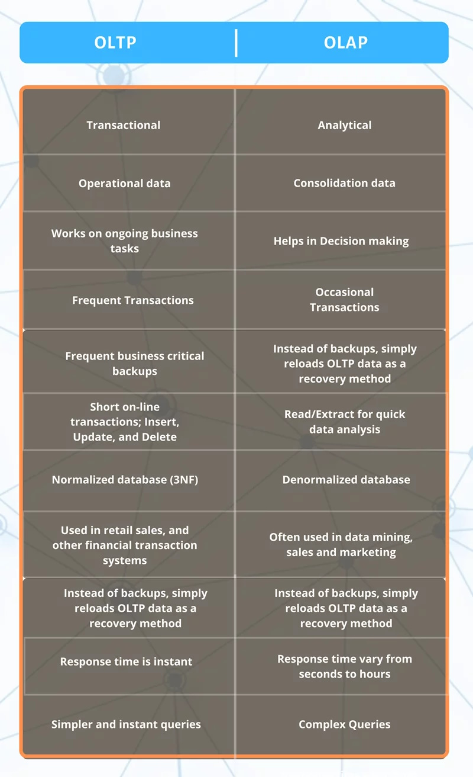
OLTP vs OLAP

Slide 7

Recommended Architecture
Cache
Build a Data App with Snowflake
Auto Sync
FE App
Result from Cache
Middleware

Slide 8
Setup Python Environment
python –m venv snowflake
cd snowflake/Scripts
activate
Go to project folder
pip install –r requirements.txt
uvicorn main:app --reload

Slide 9
Curl Scripts
- curl localhost:8000/
- curl localhost:8000/ping
- curl localhost:8000/getTotalNLA
- curl localhost:8000/getLeaseExpiry
- curl localhost:8000/getPortfolioCommitedOccupancy
- curl localhost:8000/getAveEffectiveGrossRent
- curl localhost:8000/getTenantMix
- curl localhost:8000/getWale
- curl localhost:8000/getRentalReversion
- curl localhost:8000/getTop10Tenants

